Slide 1
Consumer Goods Ad hoc Insights
Presenter : Gaurav Bharat Raut

Slide 2
Company Overview
Atliq Hardware is one of the leading computer hardware producers in India as well as 26 other countries across the globe.
Manufactures products under 3 major divisions i.e., Peripherals & Accessories, PC, Networking & Storage.
We have a total of 74 Customers like Neptune, Sage, Leader, Vijay Sales etc. across all markets/countries.

Slide 3
Objective
Assist the management team to gain more insights about the business.
Take data-driven decisions to scale business.

Slide 4
About data
We have 4 fact tables i.e., sales monthly, manufacturing cost, pre invoice deductions, gross price which have measurable metrics and 2 dimension table i.e., customer details and product details.
Fiscal year for Atliq Hardware starts from 1st September and ends on 31st August each year
Sales data is available for fiscal year 2020-2021.

Slide 5
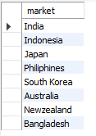
1. Provide the list of markets in which customer "Atliq Exclusive" operates its business in the APAC region.
SELECT distinct market
FROM dim_customer
where customer = "Atliq Exclusive“
and
region ="APAC"

Slide 6
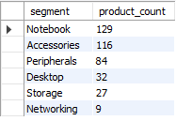
3. Provide a report with all the unique product counts for each segment and sort them in descending order of product counts. The final output contains 2 fields, segment product_count
select
segment , count(distinct(product_code)) as product_count
from dim_product
group by segment
order by product_count desc

Slide 7

5. Get the products that have the highest and lowest manufacturing costs. The final output should contain these fields, product_code product manufacturing_cost
SELECT pro.product_code,pro.product ,cost.manufacturing_cost
FROM fact_manufacturing_cost as cost
join dim_product as pro
on cost.product_code=pro.product_code
where manufacturing_cost=
(select max(manufacturing_cost) from fact_manufacturing_cost)
Or
manufacturing_cost=
(select min(manufacturing_cost) from fact_manufacturing_cost)
order by manufacturing_cost desc

Slide 8
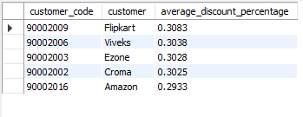
6. Generate a report which contains the top 5 customers who received an average high pre_invoice_discount_pct for the fiscal year 2021 and in the Indian market. The final output contains these fields, customer_code customer average_discount_percentage
SELECT cust.customer_code,cust.customer , round(avg(pre_invoice_discount_pct),4) as average_discount_percentage
FROM fact_pre_invoice_deductions as invoice
join dim_customer as cust
on invoice.customer_code=cust.customer_code
where market ="India" and fiscal_year = 2021
group by cust.customer_code , cust.customer
order by average_discount_percentage desc
limit 5

Slide 9
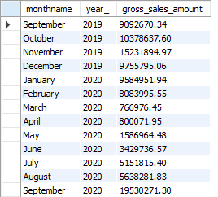
7. Get the complete report of the Gross sales amount for the customer “Atliq Exclusive” for each month. This analysis helps to get an idea of low and high-performing months and take strategic decisions. The final report contains these columns: Month Year Gross sales Amount
SELECT monthname(date) as monthname ,
year(date) as year_ , round(sum(gross_price*sold_quantity),2) as gross_sales_amount
FROM fact_gross_price as price
join fact_sales_monthly as sales
on price.product_code=sales.product_code
join dim_customer as cust
on sales.customer_code=cust.customer_code
where cust.customer="Atliq Exclusive“
group by monthname , year_
order by year_

Slide 10
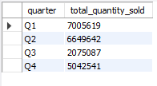
8. In which quarter of 2020, got the maximum total_sold_quantity? The final output contains these fields sorted by the total_sold_quantity, Quarter total_sold_quantity
SELECT case
when month(date) in (9,10,11) then "Q1"
when month(date) in (12,1,2) then "Q2“
when month(date) in (3,4,5) then "Q3"
else "Q4" end as quarter ,
sum(sold_quantity) as total_quantity_sold
FROM fact_sales_monthly
where fiscal_year = 2020
group by quarter

Slide 11

9. Which channel helped to bring more gross sales in the fiscal year 2021 and the percentage of contribution? The final output contains these fields, channel gross_sales_mln percentage
with sales_amount as
(SELECT cust.channel ,
ound(sum(gross_price*sold_quantity)/1000000,2) as gross_sales_amount
FROM fact_gross_price as price
join fact_sales_monthly as sales
on price.product_code=sales.product_code
join dim_customer as cust
on sales.customer_code=cust.customer_code
where sales.fiscal_year = 2021
group by channel
order by gross_sales_amount desc)
select
channel , gross_sales_amount,
round(gross_sales_amount/(sum(gross_sales_amount) over())*100,2) as percentage
from sales_amount

Slide 12
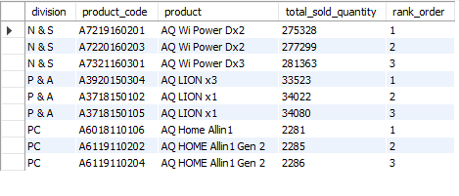
with top_products as
(SELECT pro.division, pro.product_code,
pro.product, sum(sales.sold_quantity) as total_sold_quantity
FROM fact_sales_monthly as sales
join dim_product as pro
on sales.product_code=pro.product_code
where sales.fiscal_year =2021
group by pro.division, pro.product_code,pro.product
order by total_sold_quantity desc)
select division,product_code,product, total_sold_quantity,rank_order from(select division,product_code,product,total_sold_quantity,
dense_rank () over(partition by division order by total_sold_quantity ) as rank_order
from top_products) test
where rank_order<=3
10. Get the Top 3 products in each division that have a high total_sold_quantity in the fiscal_year 2021? The final output contains these fields,
division product_code product total_sold_quantity rank_order

Slide 13
THANK YOU

